Slide 1
Reactive programming intro

Slide 2
What is Reactive Programming?

Slide 3

Programming with asynchronous data streams

Slide 4
asynchronous data
Code will run independently to the main program flow

Slide 5
But, What is a stream ...?

Slide 6
A sequence of events order in time.

Slide 7

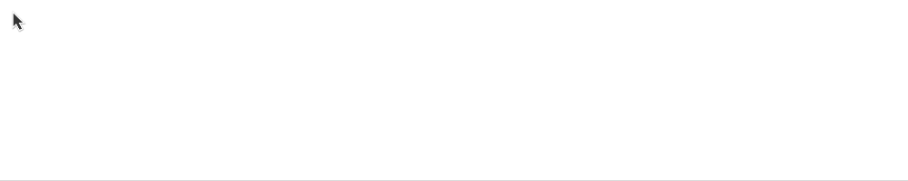

Cache events
anything that may change or happen
Variables
Events
Sensor’s measures
Failures
Notes:
https://dzone.com/articles/5-things-to-know-about-reactive-programming

Slide 8

So, why is it called reactive programming?
You can listen to a stream…
and react accordingly.
Notes:
https://gist.github.com/staltz/868e7e9bc2a7b8c1f754

Slide 9
Stream characteristics
Stream is asynchronous
You can listen to a Stream
can emit three different things: a value (of some type), an error, or a "completed" signal
You can define functions that will execute when a value is emitted
Notes:
Change the location of this page

Slide 10
ASCII representation of a stream
--a---b-c---d---X---|->
---> is the timeline (frames)
a, b, c, d are emitted values
X is an error
| is the 'completed' signal

Slide 11
Counter stream of button clicks
clickStream: ---c----c--c----c------c-->
vvvvv map(c becomes 1) vvvv
---1----1--1----1------1-->
vvvvvvvvv scan(+) vvvvvvvvv
counterStream: ---1----2--3----4------5-->
* scan is an aggregate function x = g(accumulated, current)

Slide 12
Double click scenario
Requirement: do something when user do mouse double click.
* Consider triple click as double click
How you would do that in a traditional imperative & stateful fashion?
Manage some kind of state with few variables
Dealing with timeline interval logic
=> Dealing with implementation - less with business logic => Reactive Programming raises the level of abstraction

Slide 14
ReactiveX - RX*
http://reactivex.io/
ReactiveX is a model implementation of the reactive programming principles.
Based on Observer pattern, iterator pattern and functional programming.
Cross platform (http://reactivex.io/languages.html)
ReactiveX provides a collection of operators filter, select, transform, combine, and compose Observables.
Notes:
https://gist.github.com/staltz/868e7e9bc2a7b8c1f754

Slide 15
RX terminology
Subject / Observable – the stream
Observers – the functions that process the stream
Subscription – listen to a stream

Slide 16
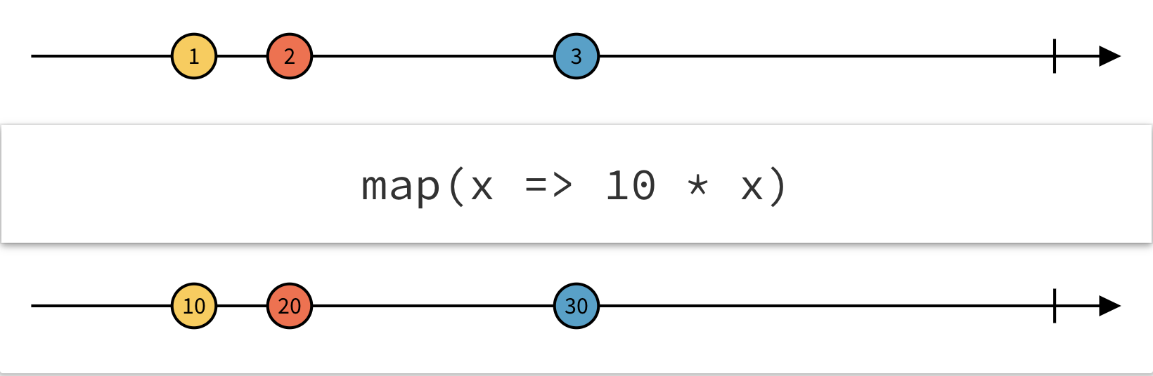
RxJS Marbels
https://rxmarbles.com/
Notes:
https://rxmarbles.com/

Slide 17
Hot / Cold Observables
Cold observables are lazy They don’t do anything until someone starts observing them (subscribe) A file download. It won’t start pulling the bytes if no one is going to do something with the data.
Hot streams are active before the subscription The data is independent of an individual subscriber. When an observer subscribes to a hot observable, it will get all values in the stream that are emitted after it subscribes. An example is a sensor
Notes:
https://dzone.com/articles/5-things-to-know-about-reactive-programming

Slide 19

Unsubscribe or face the consequences !!!

Slide 20
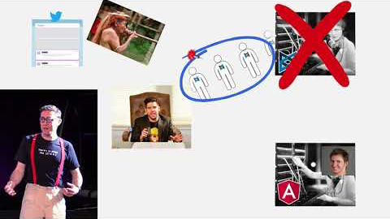
SwitchMap killer movie (20 minutes)

